Slide 1
Neural Networks and SciML (with a wink to multigrid)
Eric C. Cyr, Sandia National Laboratories

Slide 2
What is SciML?
ChatGPT 4o (April 2nd 2025)
SciML, or Scientific Machine Learning, is
an emerging field
We are still working on a definition
that integrates scientific computing with machine learning techniques
ML helps scientific computing
to address complex scientific and engineering problems.
We all want to solve hard problems
The goal of SciML is to leverage the strengths of both domains to enhance modeling, simulation, and data analysis.
Formatting and colored text is mine…
Term “SciML” is from this 2019 report
Notes:
From the SciML Report: “Scientific machine learning (SciML) is a core component of artificial intelligence (AI) and a computational technology that can be trained, with scientific data, to augment or automate human skills.”

Slide 3
Outline
Neural Networks
SciML Use Cases
Physics-Informed Neural Networks
Operator Networks
Neural Networks for Approximation
Spectral Bias
Least-Squares: Advection-Diffusion, Stokes
Layer-Parallel Training
Conclusion

Slide 4
Neural Networks: Architecture
A neural network is a parameterized model:
Neural Network
Output
Input
Parameters
It is composed of multiple layers*
Feature Vectors

Slide 5
Neural Networks: Architecture
 | Update Rule
Feed Forward
ResNet
Activation Function
Bias Vector
Weighting Matrix

Slide 6
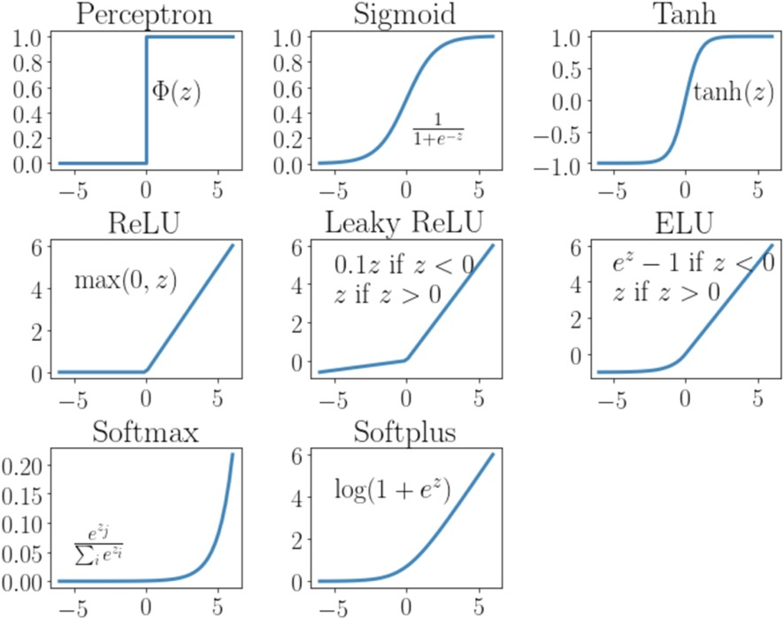
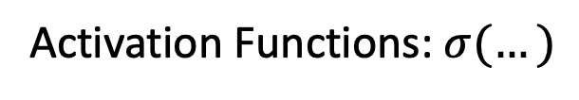
Neural Networks: Architecture
Activation Functions: $σ(…)$
From: Johnson, N.S., Vulimiri, P.S., To, A.C., Zhang, X., Brice, C.A., Kappes, B.B. and Stebner, A.P., 2020. Invited review: Machine learning for materials developments in metals additive manufacturing. Additive Manufacturing, 36, p.101641

Slide 7

Neural Networks: Universal Approximation
G. Cybenko. Approximation by superpositions of a sigmoidal function. Mathematics of Control, Signals, and Systems, 1989.
(Was at 1988-1992)
Hornik, K., Stinchcombe, M. and White, H., 1989. Multilayer feedforward networks are universal approximators. Neural networks, 2(5), pp.359-36
More theory from: R. Devore, J. Xu, J. Siegel, B. Hanin, M. Telgarsky, …
(Occasional Copper Attendees)

Slide 8
Neural Networks: Training
Neural network should map data according to the sampled training set :
Input
Output
Find $Θ$ minimizing the loss in the model over the training set:
Parameters
Loss function is model/data difference:

Slide 9
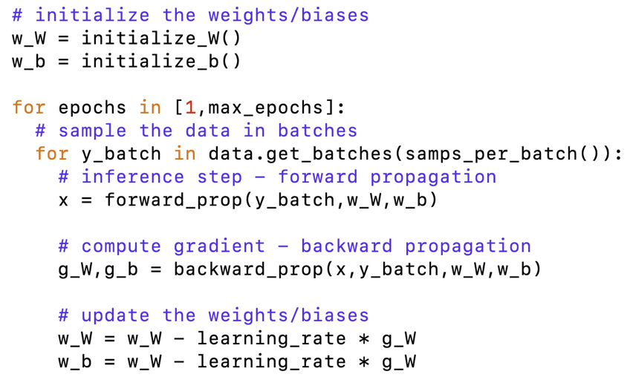
Neural Networks: Training
Stochastic Gradient Descent Algorithm:
Dictionary:
Epoch: One pass through the data set, one gradient has been computed for each of
Batch: A subset of the data set with sampled randomly without replacement. A loop over all batches in a data set, means one epoch has been completed.
Batch Size: Number of samples in a batch, excluding the last one (which depending on modulo arithmetic can be smaller)
Learning Rate: Step length for gradient descent
Batched SGD samples from the data space defining the global loss
Reduces required memory footprint
Uses samples more efficiently (see Bottou, Curtis, Nocedal)
Original SGD paper: Robbins, Monro. "A stochastic approximation method." The annals of mathematical statistics (1951): 400-407.

Slide 10
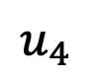
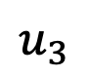
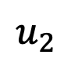
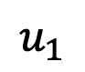
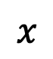
Neural Networks: Training
Gradient updates in SGD look like
1. Forward Solve
Layer 1
Layer 2
Layer 3
Input
Output
The adjoint method/backpropagation computes the gradient
$$x$$
$$u_{1}$$
$$u_{2}$$
$$u_{3}$$
$$u_{4}$$
Layer 1
Layer 2
Layer 3
Gradient
Obj. Sens.
2. Adjoint Solve

Slide 11
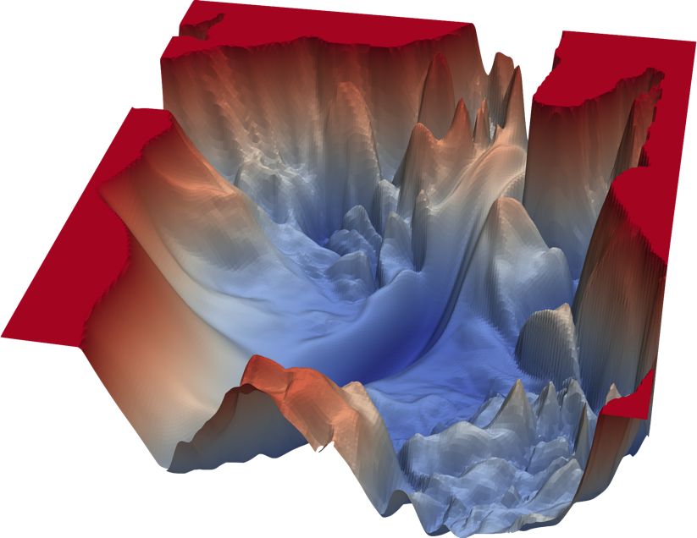
Neural Networks: Training
Why not higher-order methods?
VGG-56: Loss in two directions
Considering this figure…why do neural networks work at all?
From: Li, H., Xu, Z., Taylor, G., Studer, C. and Goldstein, T., 2018. Visualizing the loss landscape of neural nets. Advances in neural information processing systems, 31

Slide 12
Neural Networks: Adaptive Basis
View a neural network as producing a “basis” followed by a projection
(output approximation)
(basis controls)
(projected coefficients)
From: Cyr, E.C., Gulian, M.A., Patel, R.G., Perego, M. and Trask, N.A., 2020, August. Robust training and initialization of deep neural networks: An adaptive basis viewpoint. In Mathematical and Scientific Machine Learning (pp. 512-536). PMLR

Slide 13
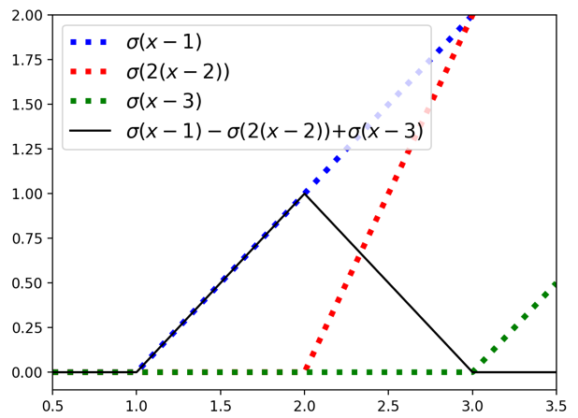
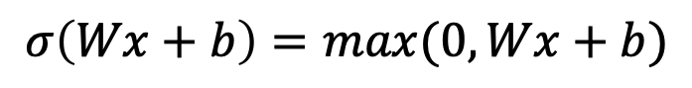
Neural Networks: Adaptive Basis
ReLUs permit a continuous p-w linear approximation
Training ReLU NN yields an r-ref. like FE method
AFEM, versus DNN-FEM
$$σ\left(Wx+b\right)=\max{(0,Wx+b)}$$
Build a FEM Basis with ReLU NN
Slope
0-Intersection
From: He, J., Li, L., Xu, J., & Zheng, C. (2020). Relu deep neural networks and linear finite elements. Journal of Computational Mathematics, 38(3), 502-527.

Slide 14
Neural Networks: Adaptive Basis
View a neural network as producing a “basis” followed by a projection
(output approximation)
(basis controls)
(projected coefficients)
Taking this perspective we will explore:
Parameter initialization
Training algorithms
From: Cyr, E.C., Gulian, M.A., Patel, R.G., Perego, M. and Trask, N.A., 2020, August. Robust training and initialization of deep neural networks: An adaptive basis viewpoint. In Mathematical and Scientific Machine Learning (pp. 512-536). PMLR

Slide 15
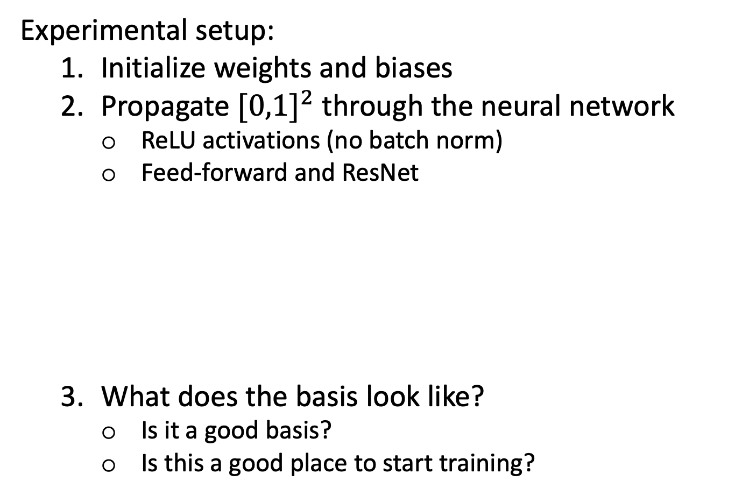
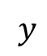
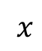
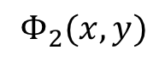
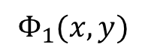
Neural Networks: Initialization
Experimental setup:
Initialize weights and biases
Propagate ${[0,1]}^{2}$ through the neural network
ReLU activations (no batch norm)
Feed-forward and ResNet
What does the basis look like?
Is it a good basis?
Is this a good place to start training?
$$x$$
$$Φ_{1}(x,y)$$
$$y$$
$$Φ_{2}(x,y)$$

Slide 16

Neural Networks: Initialization
“He*” is a standard technique: for ReLU’s with batch norm
Current layer
$$x$$
$$Φ_{1}(x,y)$$
$$y$$
$$Φ_{2}(x,y)$$
Image of layer
Plot the image of ${[0,1]}^{2}$ through all layers
ResNet
Size of hypercube
*He, K., Zhang, X., Ren, S., & Sun, J. (2015). In Proceedings of the IEEE international conference on computer vision (pp. 1026-1034).

Slide 17
Neural Networks: Initialization
ResNet
Each layer update is:
Related to exploding/vanishing gradients, if initialized weights are too large inference with DNN will be unstable

Slide 18
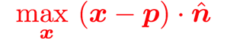

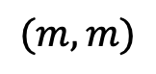
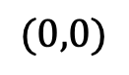
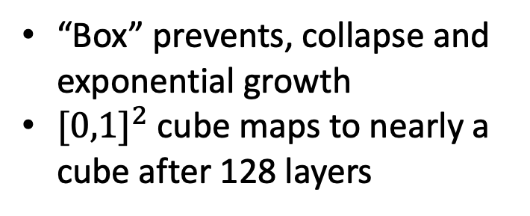
Neural Networks: Initialization
Goals:
Remain Bounded
Don’t Collapse: Requires growth of cell size
Keep cut-plane is in cell at each layer
$$(m,m)$$
Initialize weights so that gives:
$$(0,0)$$
“Box” prevents, collapse and exponential growth
${[0,1]}^{2}$ cube maps to nearly a cube after 128 layers

Slide 19
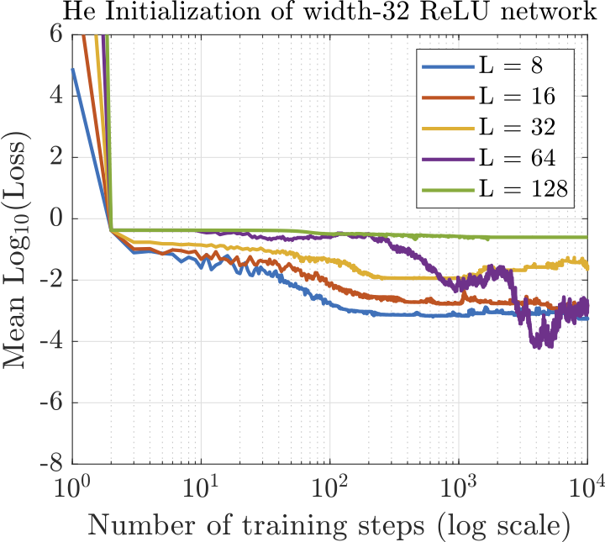
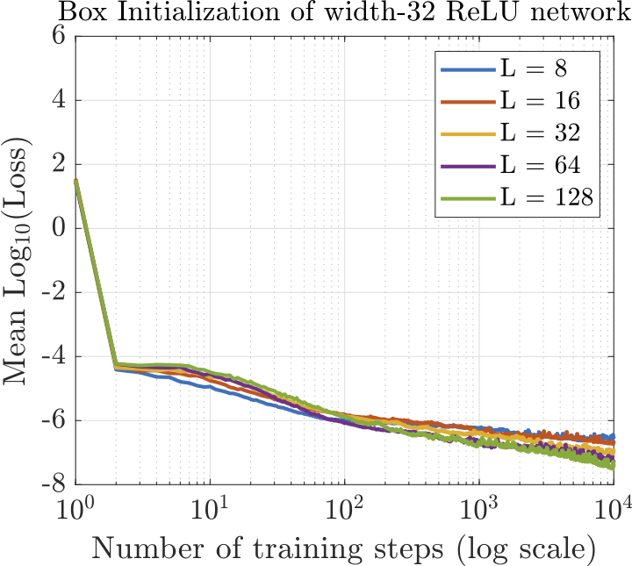
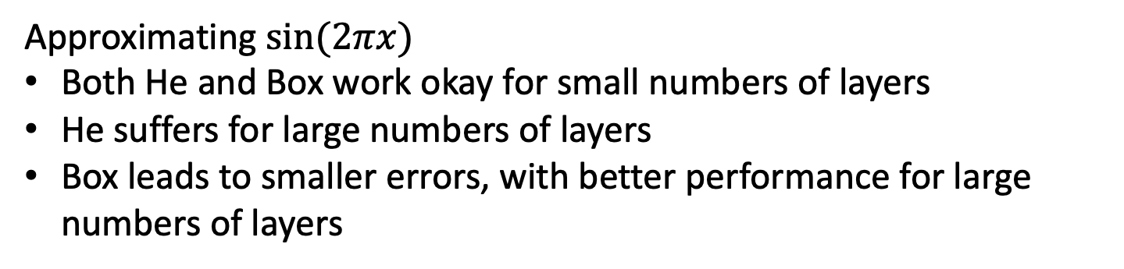
Neural Networks: Initialization
Approximating $\sin{(2πx)}$
Both He and Box work okay for small numbers of layers
He suffers for large numbers of layers
Box leads to smaller errors, with better performance for large numbers of layers

Slide 20
Neural Networks: Neural ODEs
A transformation: from ResNets to Neural ODEs
Consider Box initialization that guarantees
See for instance:
Haber, Ruthotto. "Stable architectures for deep neural networks." Inverse Problems 34, no. 1 (2017).
Chen, Rubanova, Bettencourt, Duvenaud. "Neural ordinary differential equations." arXiv preprint arXiv:1806.07366 (2018).

Slide 21
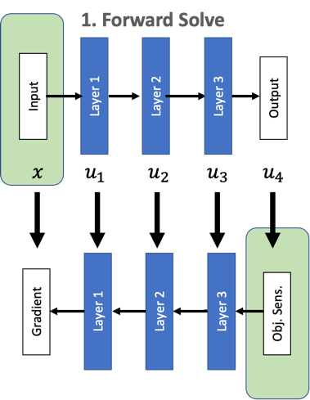
Neural Networks: Wrap up
Neural Networks are:
Parameterized models
Typically trained with gradient descent
Unstable if not properly initialized
Neural network training:
Is computationally expensive
Is composed of forward propagation, and a backward (adjoint pass)
With second order methods is difficult
Can be viewed as adaptive refinement of a basis
Question: Are there other perspectives on neural networks that are useful to consider that help with method design?

Slide 22
Use Case: PINNS (Physics-Informed Neural Nets)
Can you solve PDEs with neural networks?
PINNS uses ${u≈u}_{N}∈V_{N}=\{$space of neural nets with parameters $θ$}
Scaling
Volume Residual
Boundary Residual
Points
Points
References:
Dissanayake, M. W. M. G., & Phan-Thien, N. (1994). Neural-network-based approximations for solving partial differential equations. Communications in Numerical Methods in Engineering, 10(3), 195-201.
Lagaris, I. E., Likas, A., & Fotiadis, D. I. (1998). Artificial neural networks for solving ordinary and partial differential equations. IEEE Transactions on Neural Networks, 9(5), 987-1000.
Raissi, M., Perdikaris, P., & Karniadakis, G. E. (2019). Physics-informed neural networks: A deep learning framework for solving forward and inverse problems involving nonlinear partial differential equations. Journal of Computational Physics, 378, 686-707

Slide 23
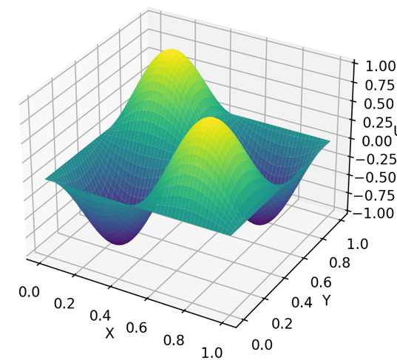
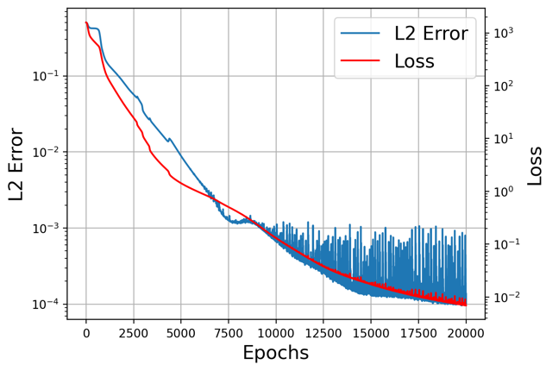
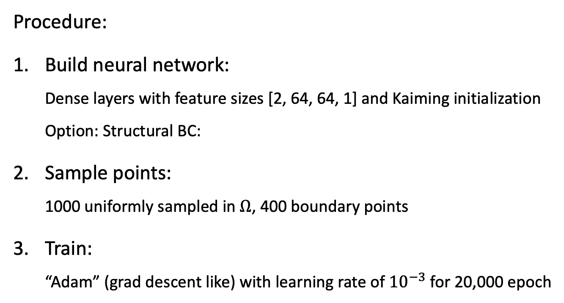
Use Case: PINNS – An Example
Check out the code!
Solve with PINNS
Procedure:
Build neural network:
Dense layers with feature sizes [2, 64, 64, 1] and Kaiming initialization
Option: Structural BC:
Sample points:
1000 uniformly sampled in $Ω$, 400 boundary points
Train:
“Adam” (grad descent like) with learning rate of ${10}^{−3}$ for 20,000 epoch
Input
Hidden
Output

Slide 24
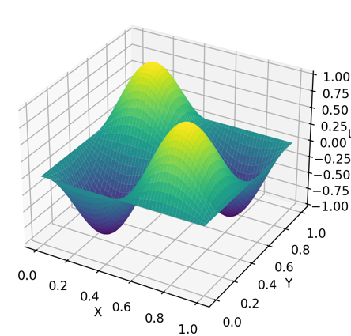
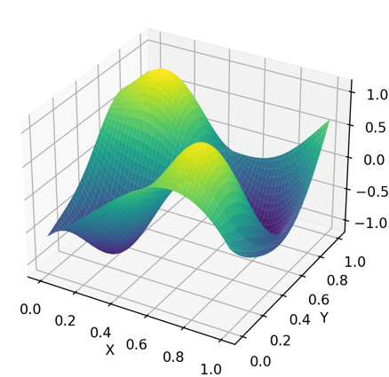
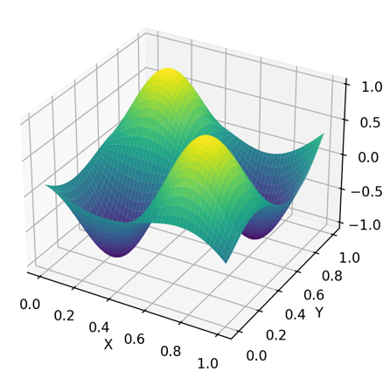

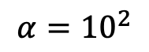
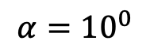
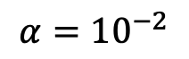
Use Case: PINNS – Boundary Conditions
Structural BC
Penalized BC
$$α={10}^{−2}$$
$$α={10}^{0}$$
$$α={10}^{2}$$
Structural enforcement of constraints is often more robust
Just like “classical” numerical methods do ☺
In PINNS this can be difficult, so penalization is used
Sensitivity to scaling, particularly boundary conditions
Automated scaling: Wang, S., Yu, X. and Perdikaris, P. When and why PINNs fail to train: A neural tangent kernel perspective. Journal of Computational Physics, (2022).
Warning: There are lots of PINNS! This is “Vanilla” PINNS, please do your background reading

Slide 25
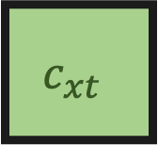

Use Case PINNS – Control Volume PINNS
Non-collocation PINNS methods have been developed (more on this later!)
Control Volume PINNS (CVPINNS): Spacetime!
$$c_{xt}$$
Replace $u$ with neural net
Introduce “inversion penalty”
From: Patel, R.G., Manickam, I., Trask, N.A., Wood, M.A., Lee, M., Tomas, I. and Cyr, E.C., 2022. Thermodynamically consistent physics-informed neural networks for hyperbolic systems. JCP, 449

Slide 26
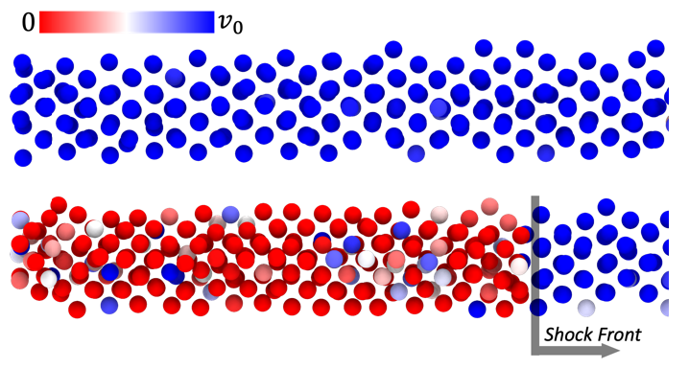
Use Case PINNS – CVPINNS
Demonstrate CVPINNS for inversion: LAMMPS data shocked copper beam
Learn the equation of state (EOS, or pressure mapping)
Replace pressure by neural net: penalties preference hyperbolicity
Solution replaced by neural net
From: Patel, R.G., Manickam, I., Trask, N.A., Wood, M.A., Lee, M., Tomas, I. and Cyr, E.C., 2022. Thermodynamically consistent physics-informed neural networks for hyperbolic systems. JCP, 449

Slide 27
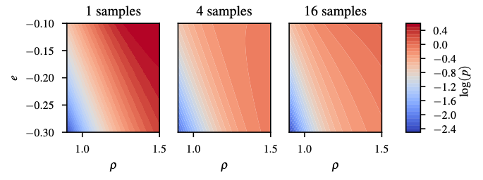
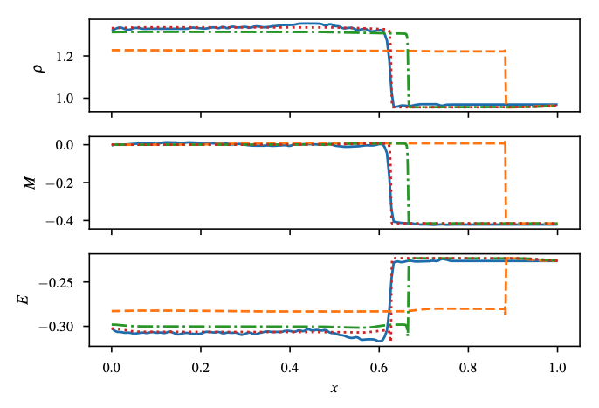
Use Case PINNS – CVPINNS
We ran 16 realizations of MD shock tube, yielding different EOS models
Training Data
Learned Copper EOS
Finite-difference solution using learned neural net EOS
LAMMPS
1 Sample fit
4 Sample fit
16 Sample fit
Notes:
Projection of training data states onto (ρ,e) plane for one case training set ( ),
four case training set ( , ), sixteen case training set ( , , ) and projection of test data ( ).
As more training data is included, the training data’s (ρ,e) states surround the test data’s
and the test case switches from extrapolation to interpolation.

Slide 28
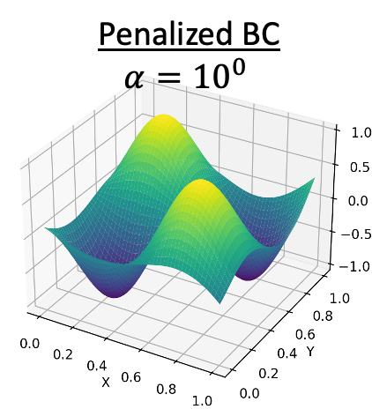
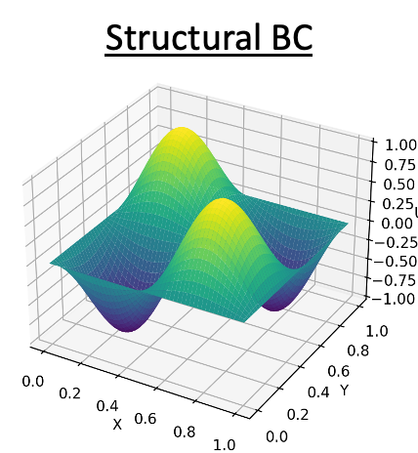
Use Case: PINNS Wrap Up
Use a neural network to approximate a PDE solution
Minimize the loss yielding a collocation like method
Allows inverse formulations
Still expensive
Gradient descent is used in general (not stochastic)
Penalizing BCs and initial conditions can fail
Practical convergence results with width/depth do not exist in general
Question: PINNS has many of the challenges of classical methods, without the benefits of convergence guarantees for instance. Why are people considering it?

Slide 29
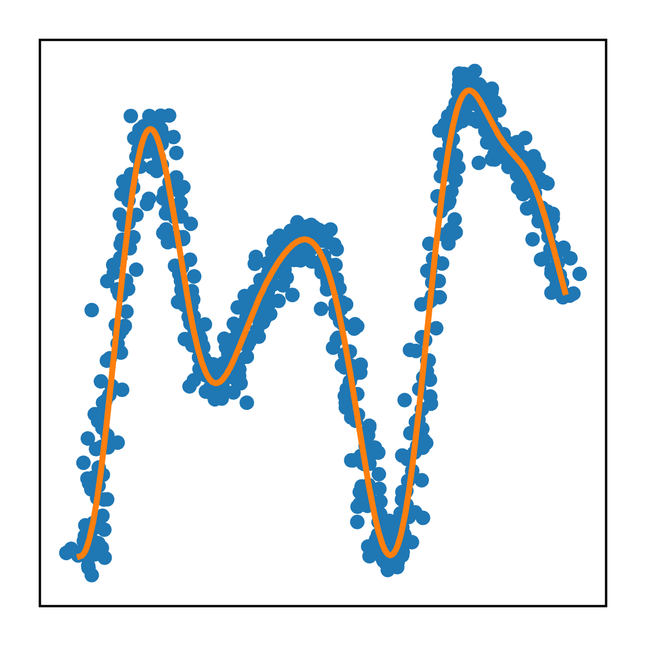
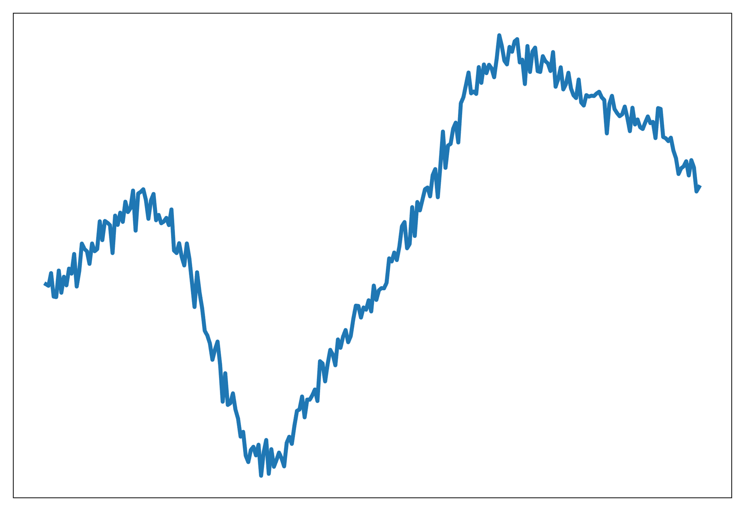
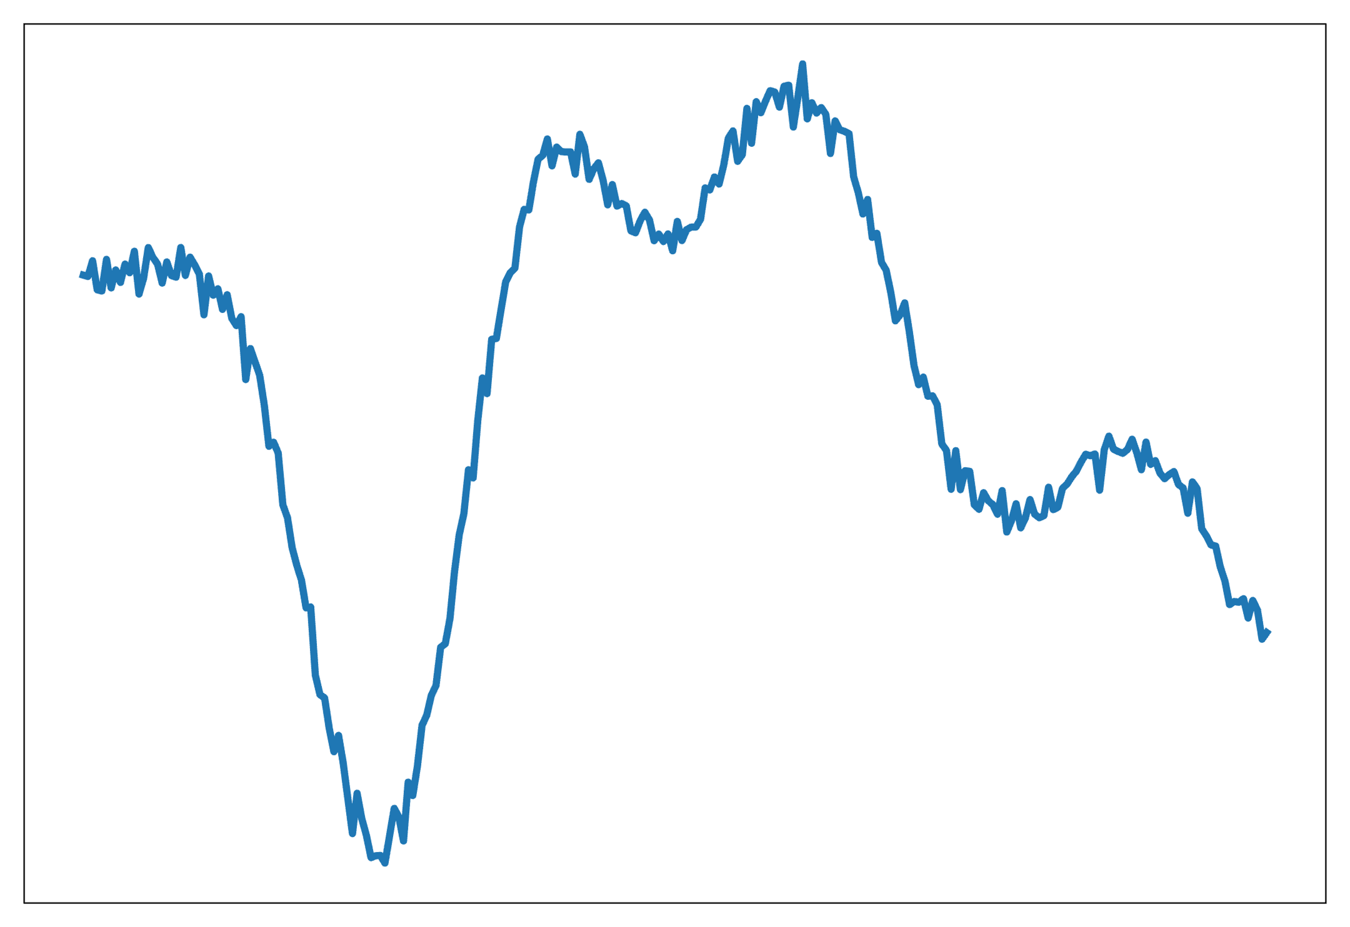
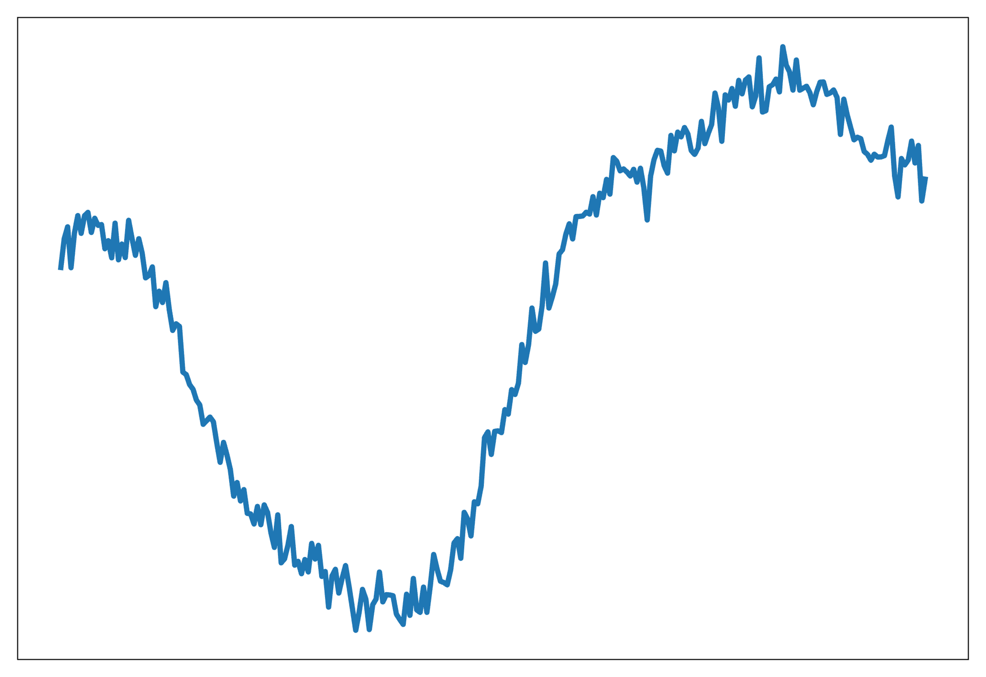
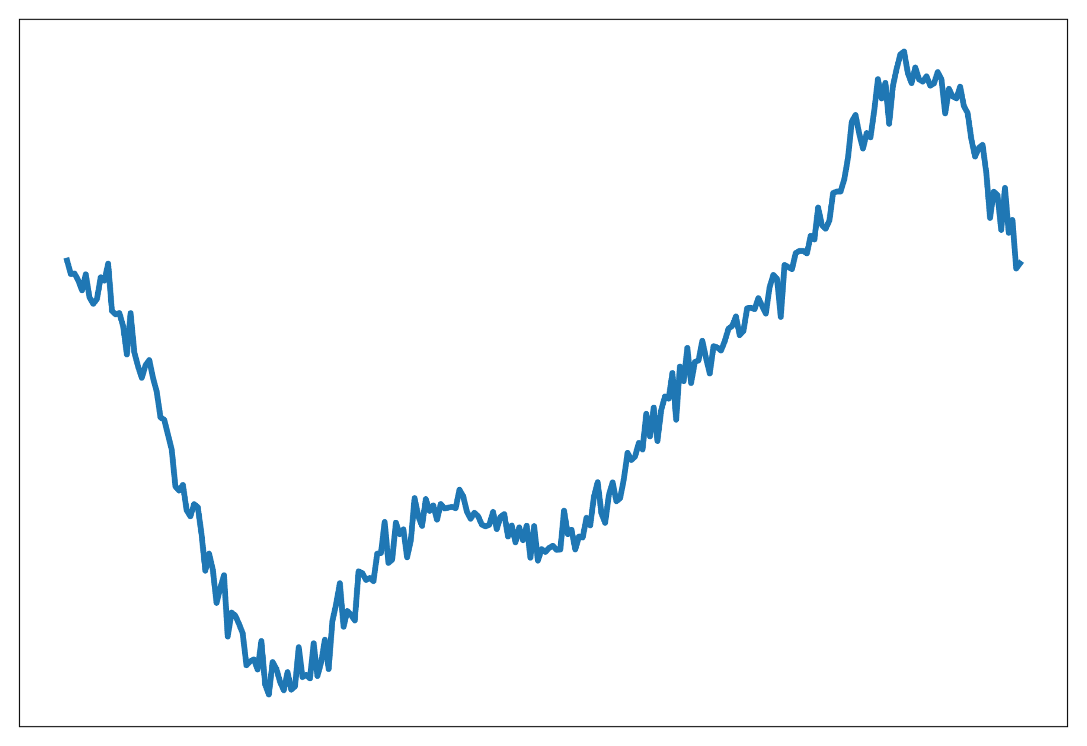
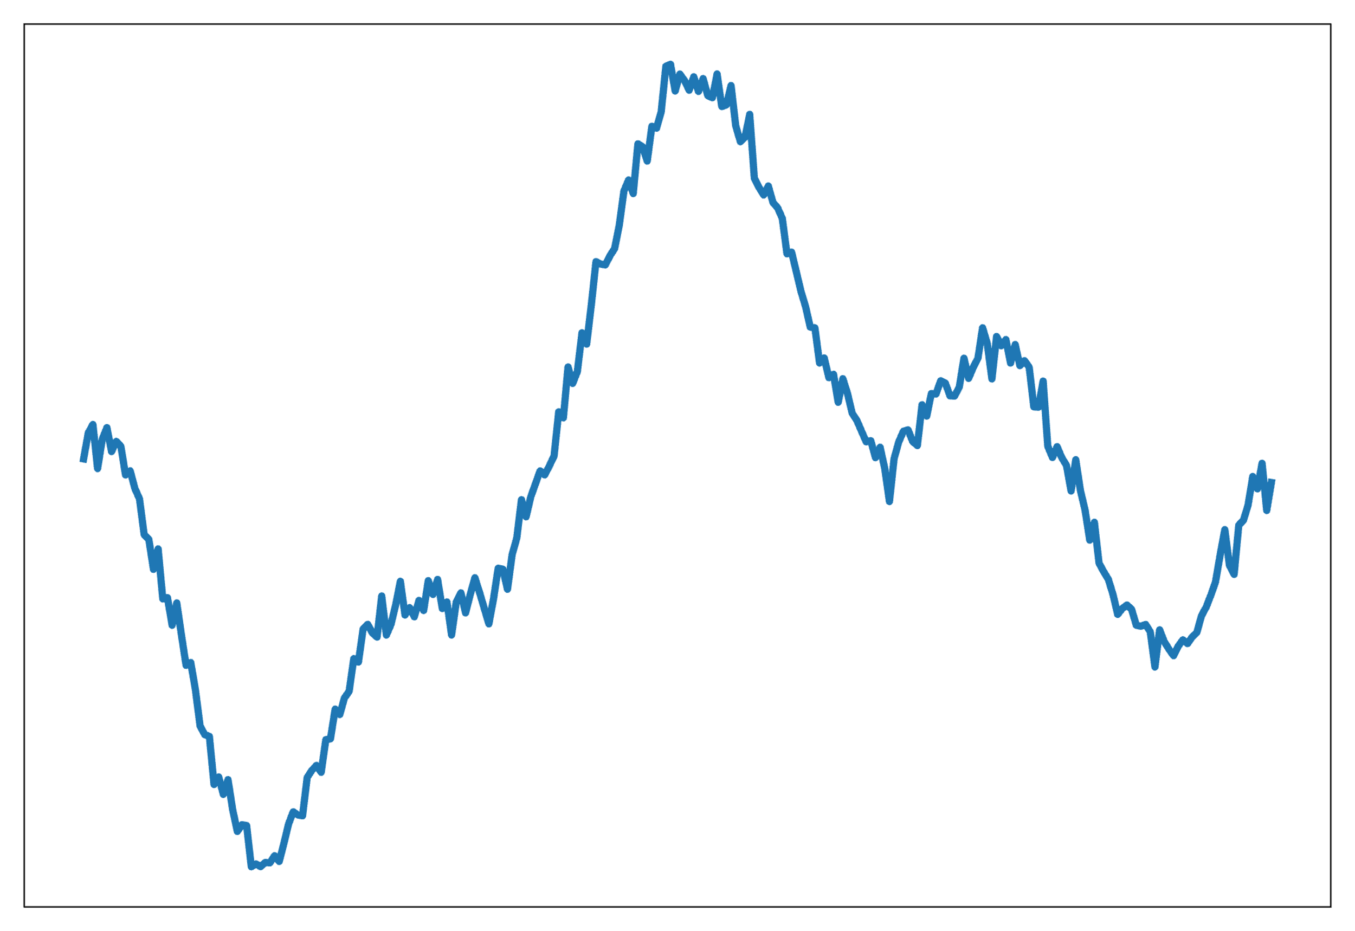
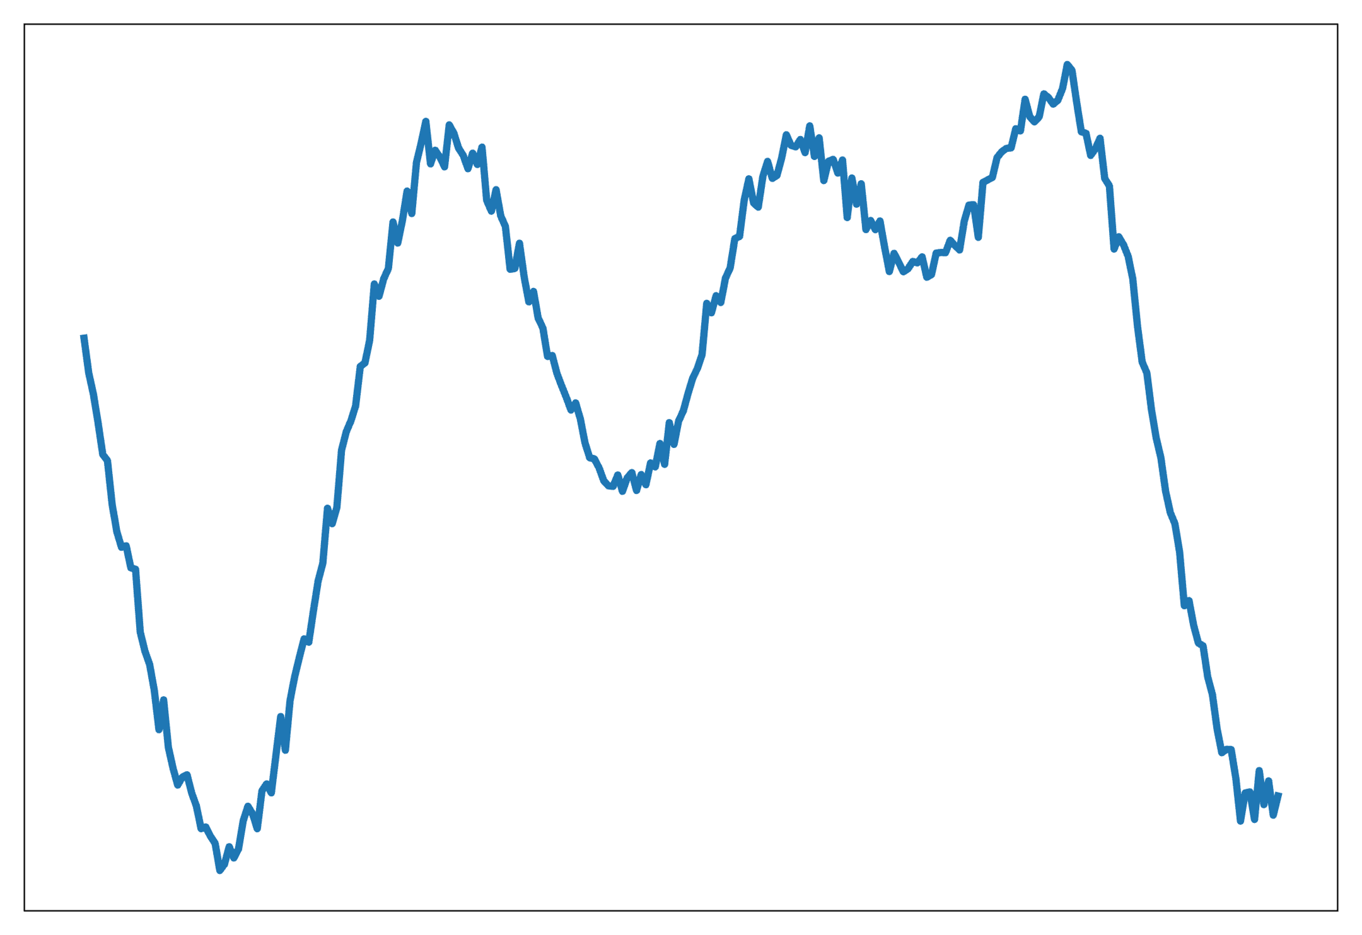
Use Case: Operator Networks*
Function Regression
Operator Regression
Observations:
- points in the domain
Observations:
- functions in the domain
- values in the range
- functions in the range
Formulation:
Formulation:
Result:
Result:
*Slide adapted from Ravi Patel’s slides

Slide 30
Use Case: MOR-Physics
Motivation for Modal Operator Regression (MOR)-Physics
Fourier Transform
Consider some generic (if simple) operators
Motivated by this we will assume there exists $g(κ)$ and $h(x)$ such that

Slide 31
Use Case: MOR-Physics
Modal Operator Regression (MOR)-Physics^{1,2}
Operator Network
Inverse Fourier Transform
Fourier Transform
Neural network: acts on Fourier frequency vector
Neural network: acts vector of function on regular grid
Following the “Operator Regression” idea we minimize
¹R.G. Patel and Desjardins, arxiv: 1810.08552 (2018)
²R.G. Patel et al., CMAME (2021)

Slide 32
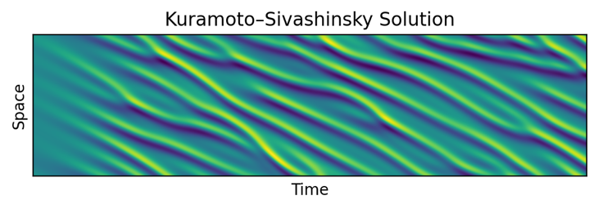
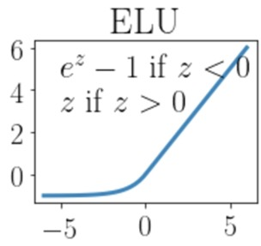
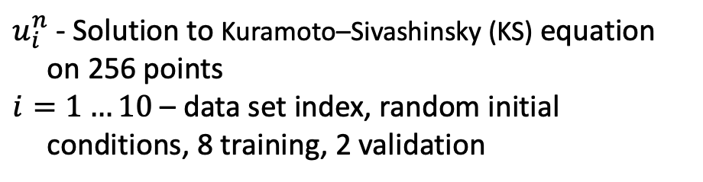
Use Case: MOR-Physics
Check out the code!
Example: Develop a surrogate operator that predicts the next time step
Dataset:
PDE time stepping, for example, Explicit Euler
$u_{i}^{n}$ - Solution to Kuramoto–Sivashinsky (KS) equation on 256 points
$i=1…10$ – data set index, random initial conditions, 8 training, 2 validation
Networks:
$g\left(κ\right),h(x)$ – networks with width 8 and depth 4, ELU activations
Training: Adam with LR=10⁻³, for 10 epochs each with k=1,2,3,4
Time step ’k’ times

Slide 33
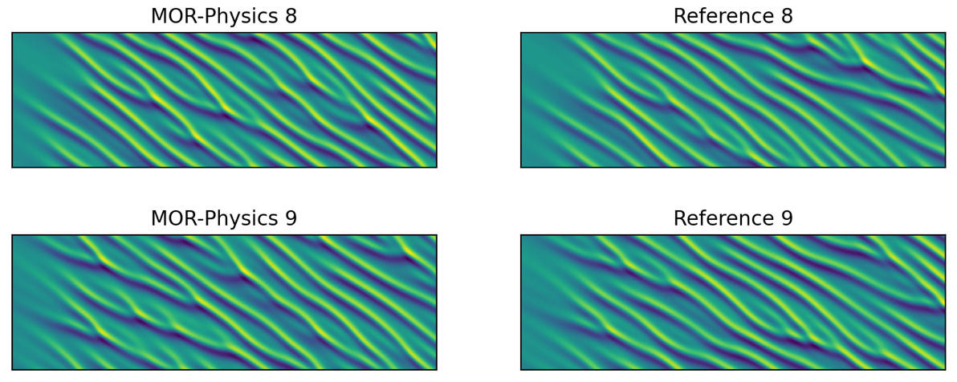
Use Case: MOR-Physics
Qualitative agreement:
KS equation is chaotic
MOR-Physics yields similar results
Learned operators match closely theoretical results
From: Patel, R.G. and Desjardins, O. Nonlinear integro-differential operator regression with neural networks. arXiv preprint arXiv:1810.08552, 2018.

Slide 34


Use Case: MOR-Physics
Use operator learning to learn a macro-scale operator of a micro-scale system
Simulate a colloidal (small and large particles) system using LAMMPS in a pressure driven channel
Find time evolution of density and momentum profiles
LAMMPS Simulation Data
MOR-Physics 4 Equation Model
From: Patel, R.G., Trask, N.A., Wood, M.A. and Cyr, E.C. A physics-informed operator regression framework for extracting data-driven continuum models. Computer Methods in Applied Mechanics and Engineering, 373, p.113500, 2021.

Slide 35

Use Case: Fourier Neural Operators (FNOs)
FNOs and MOR-Physics are similar
Both built around learning operators in Fourier space
FNOs often introduce “Latent Space Dynamics”
FNOs have a broader architecture, but “kernel” is identical
From: Li, Z., Kovachki, N., Azizzadenesheli, K., Liu, B., Bhattacharya, K., Stuart, A. and Anandkumar, A., 2020. Fourier neural operator for parametric partial differential equations. arXiv preprint arXiv:2010.08895

Slide 36

Use Case: Deep Operator Nets (DeepONets)
DeepONets exploit neural networks as a basis
Representative DeepONet
Branch Net: Coefficients
Trunk Net: Basis
DeepONet architecture
Branch produces coefficients from input function
Pictured: Function ‘u’ represented at 3 points $({\vec{x}}_{0},{\vec{x}}_{1},{\vec{x}}_{2})$
Trunk evaluates basis at point in domain
Pictured: $(x,y)$ in a 2D domain
Number of basis functions: width of final branch/trunk layer
Pictured: $B=5$
Dense architecture typically used (others have been explored)
Pictured: Branch with a [3,4,4,5], Trunk with [2,3,3,5]
Branch
Trunk
From: Lu, L., Jin, P., Pang, G., Zhang, Z. and Karniadakis, G.E., 2021. Learning nonlinear operators via DeepONet based on the universal approximation theorem of operators. Nature machine intelligence, 3(3), pp.218-229

Slide 37




Use Case: DeepONets – Ice Sheet Modeling
Model for flow of ice sheets glacier
Thickness
Equation
ice thickness
vertically avg. velocity
accumulation/ablation
Stokes
Equation
$$\left\{\begin{matrix}−∇⋅σ\left(u_{β}^{n}\right)=ρg in Ω_{H^{n}} \\ ∇⋅u_{β}^{n}=0 in Ω_{H^{n}}\end{matrix}\right.\begin{matrix} \\ \end{matrix}$$
Stress term depends on spatially varying unknown basal friction $β$
Solution Algorithm: Operator split between Stokes and “Thickness transport”
A Hybrid Method
$$\frac{H_{β}^{n+1} −H_{β}^{n}}{Δt}+∇⋅\left({\overline{u}}_{β}^{n} H_{β}^{n+1}\right)=F_{H}^{n+1}$$
$${\overline{u}}_{β}^{n}=𝒢(β, H^{n})$$
Idea: Replace expensive
Stokes solve with DeepONet
From: He, Q., Perego, M., Howard, A.A., Karniadakis, G.E. and Stinis, P., 2023. A hybrid deep neural operator/finite element method for ice-sheet modeling. Journal of Computational Physics, 492, p.112428

Slide 38
















Use Case: DeepONets – Ice Sheet Modeling
Branch network
Input/Output:
Branch input size: $(M)$
Trunk input size: $(2)$
Target size: $\left(2\right)$
Training size: $({2 M N}_{β})$
$$β_{i}(x_{1},y_{1})$$
$$β_{i}(x_{2},y_{2})$$
$$W$$
$$c_{k}(β_{i})$$
$$M$$
Branch network
target
$$⋯$$
$$β_{i}(x_{M},y_{M})$$
$$W$$
$\overline{u}(β_{ })(x,y$)
Legend: $M$: size of spatial grid
$N_{β}$: number beta samples
$N_{T}$: number of time snapshots
compare
X
$${𝒢(β}_{i})(x,y)$$
Trunk network
Velocity and thickness data are generated by the FEM code, implemented in FEniCS
$$W$$
$$(x,y)$$
$$2$$
$$φ_{k}(x,y)$$
$$W$$
From: He, Q., Perego, M., Howard, A.A., Karniadakis, G.E. and Stinis, P., 2023. A hybrid deep neural operator/finite element method for ice-sheet modeling. Journal of Computational Physics, 492, p.112428

Slide 39


Use Case: DeepONets – Ice Sheet Modeling
Building the model:
# training beta samples: 300
#epochs: 300,000
4 layers of width W: 300
time snapshots: 1, 2, …, 100
extrapolation
Stokes
Including “off-line” costs, Hybrid DeepOnet becomes advantageous over traditional model for more than 500 samples
From: He, Q., Perego, M., Howard, A.A., Karniadakis, G.E. and Stinis, P., 2023. A hybrid deep neural operator/finite element method for ice-sheet modeling. Journal of Computational Physics, 492, p.112428

Slide 40

Use Case: Operator Networks Wrap Up
Operator networks are neural networks that approximate an operator
These are really about building surrogates
Enable UQ, optimization
Suitable for multiple iterations
Still require simulation results
Incorporation of observed data is possible
”Hybrid” SciML/Scientific Computing
Question: Surrogates have been developed for years and I’ve seen lots of talks about how to build them. How are they used currently, and what are gaps?

Slide 41
Approx. with NN: Spectral Bias
What are the difficulties of approximating with neural networks?
(output)
(basis controls)
(projected coefficients)
Thought experiment: After training, what if a single entry in a weight matrix is perturbed? What happens to the prediction?
Hint: Activations like ReLU are NOT locally supported
Answer: Prediction will change everywhere across the domain

Slide 42
Approx. with NN: Spectral Bias
Unlike compactly supported basis, this makes local perturbations of predictions difficult
This relates to the well known “spectral bias” issue
In training of neural networks “Low Frequencies are Learned First”
From: Rahaman, N., Baratin, A., Arpit, D., Draxler, F., Lin, M., Hamprecht, F., Bengio, Y. and Courville, A., 2019, May. On the spectral bias of neural networks. In International conference on machine learning (pp. 5301-5310). PMLR

Slide 43
Approx. with NN: Spectral Bias
Minimizing with gradient descent
Gradient Descent
to
Gradient Flow
Given the “flow” of parameters, how does the prediction change?
Residual

Slide 44
Approx. with NN: Spectral Bias
B. Southworth’s talk will look at a view of preconditioning can help with training
Matrix $G^{T}G$ is the Neural Tangent Kernel (NTK). Eigenvalues of NTK can be used to describe convergence
High Frequency
Low Frequency
From: Wang, S., Yu, X. and Perdikaris, P. When and why PINNs fail to train: A neural tangent kernel perspective. Journal of Computational Physics, (2022).
Notes:
Ben Southworth’s talk

Slide 45
Approx. with NN: Spectral Bias Wrap Up
Low Frequencies are Learned First for neural networks trained with gradient descent
Training with gradient descent is like Richardson iteration
But in Richardson, high frequencies are first
I contend this is related to the structure, and global support used by neural networks
The Neural Tangent Kernel is a useful tool to understand gradient descent behavior
G. Harper’s talk will look at a different class of networks that expose local support
Hard Question for Graham: A key advantage of neural networks is high dimensional approximation, how does this work if you have local support?

Slide 46
Approx. with NN: Discontinuities
Leverage natural “adaptivity” of neural networks to solve for discontinuities in conservation laws
Loss computed with adaptive quadrature and “upwind” derivative
Volume Integral
Boundary Penalty
Upwind Derivative
From: Cai, Z., Choi, J. and Liu, M., 2024. Least-squares neural network (LSNN) method for linear advection-reaction equation: discontinuity interface. SIAM Journal on Scientific Computing, 46(4), pp.C448-C478

Slide 47

Approx. with NN: Discontinuities
There exists a ReLU NN with depth $\left\lceil \log_{2}(d+1\left.)\right\rceil +1\right.$ approximating a d-dimensional step function generated by advection-reaction to a prescribed accuracy
This helps define a required bound for a hyper parameter
From: Cai, Z., Choi, J. and Liu, M., 2024. Least-squares neural network (LSNN) method for linear advection-reaction equation: discontinuity interface. SIAM Journal on Scientific Computing, 46(4), pp.C448-C478

Slide 48

Approx. with NN: Discontinuities
Problem Setup
Exact Solution
2-300-1 ReLU NN
Breaking Planes
2-5-5-1 ReLU NN
Uses Adam for 200k iterations with an adaptive learning rate
Z. Cai and collaborators T. Ding, A. Doktorova, and C. Herrera have talks with related approaches

Slide 49

Approx. with NN: Least Squares Stokes Flow
Recent work takes a similar approach for Stokes flow solving for a neural net solution
Integral uses Riemann sums over point clouds
Interesting discussion on impact of choice of norms
Method | $$a_{1}$$ | $$a_{2}$$ | $$a_{3}$$ | $$a_{4}$$
Norm Equivalent | 0 | 1 | 1 | 3/2
PINNS | 0 | 0 | 0 | 0
PINNS + Sobolev Training | 1 | 1 | 1 | 1
Weaker Trace | 0 | 1 | 1 | 1
From: Meissner, Huynh, Kuberry, Bochev, A deep least-squares method for the Stokes equations, Accepted to CAMWA, 2025.

Slide 50
Approx. with NN: Least Squares Stokes Flow
Problem Setup
Relative L2 Error
MSE Residuals
Why is this interesting?
Choice of norm has strong impact on error (like Cai’s work too!)
Obvious PINNS choice is the wrong one
Weaker Trace
Norm Equivalent
PINNS
PINNS + Sobolev Training
From: Meissner, Huynh, Kuberry, Bochev, A deep least-squares method for the Stokes equations, Accepted to CAMWA, 2025.

Slide 51
Approx. with NN: Wrap Up
Neural networks build an approximation space used in a variational formulation
Least squares is a natural formulation
Proper formulation of loss eliminates “generalization error” at convergence
Others (not least squares)
W. E, B. Yu, Deep Ritz, Communications in Mathematics and Statistics, 2018.
M. Ainsworth, J. Dong, Galerkin Neural Networks, SISC, 2021 (Adaptive)
Question: To what extent can/should neural networks replace classical discretizations? What are the major gaps? What are the advantages?

Slide 52
Multilevel Training: Training Transformers
Nested Iteration is a common approach (“transfer learning”)
Train a coarse network
Transfer parameters to fine network
Train fine network
Zou, L., Zhang, H. and Deng, Y., A Multi-Level Framework for Accelerating Training Transformer Models. In The Twelfth International Conference on Learning Representations, 2024.

Slide 53
Multilevel Training: Training Review
Gradient updates in SGD look like
1. Forward Solve
Layer 1
Layer 2
Layer 3
Input
Output
The adjoint method/backpropagation computes the gradient
$$x$$
$$u_{1}$$
$$u_{2}$$
$$u_{3}$$
$$u_{4}$$
Layer 1
Layer 2
Layer 3
Gradient
Obj. Sens.
2. Adjoint Solve

Slide 54
Multilevel Training: Layer-Parallel
Input
Layer 1
Layer 2
Layer 3
Layer 4
Final Layer
Output
How reduce runtime with increased neural network depth?
Double the number of layers
Input
Layer 1
Layer 2
Layer 3
Layer 4
Layer 5
Layer 6
Layer 7
Layer 8
Final Layer
Output
Further increase layer count
Input
Layer 1
Layer 2
Layer 3
Layer 4
…
Layer 2^{n}-2
Layer 2^{n}-1
Layer 2^{n}
Final Layer
Output
Potential Architectures:
ResNet’s
NeuralODEs
Recurrent Neural Networks
Current parallelism mitigates increasing data set sizes and network width:
Increased runtimes with depth are not reduced by traditional approaches!

Slide 55


55
A simple idea:
Process each layer in parallel
This will distribute computation
Stochastic Gradient Descent Algorithm:
But it won’t work!
Forward/Back prop are serial
Distributing the layers does not lead to acceleration

Slide 56


Multilevel Training: Layer-Parallel
A simple idea:
Process each layer in parallel
This will distribute computation
Stochastic Gradient Descent Algorithm:
But it won’t work!
Forward/Back prop are serial
Distributing the layers does not lead to acceleration
$$+ε_{f}$$
$${+ε}_{b}$$
Idea: Introduce a small error

Slide 57
Multilevel Training: Layer-Parallel
Assumptions
Objective Constraints:
Summable conditional biases:
Biased gradient estimator:
Gradient estimator has bounded variance:
Theorem (Lin, 2022): For a nonconvex objective, with the above assumptions, and $α_{k}<1/L$, then
Take Home: SGD with inexact gradients leads to small expected gradients
Shengchao Lin, “Multilevel-in-Time Methods for Optimal Control of PDEs and Training of Recurrent Neural Networks”, Rice University, 2022.

Slide 58
Multilevel Training: Layer-Parallel
Inexactness allows us to propagate approximately: Trade exactness for parallelism!
Layer 1
Layer 2
Layer 3
Layer 4
Layer 5
Layer 6
Layer 7
Layer 8
Input
Final Layer
Output
Proc 1
Proc 2
Proc 3
Proc 4
How will we achieve this inexactness/parallelism?
Treat ”Layers as Time Dimension” and then apply Parallel-in-Time
Lots of options: Gander, “50 years of time parallel time integration,” 2015.
Parareal: Lions, Maday, Turinici, C. R. Acad. Sci. Paris Sér. I Math. 332 2001.
PFASST: Emmett, Minion. Communications in Applied Mathematics and Computational Science 7, 2012.
MGRIT: Falgout, Friedhoff, Kolev, MacLachlan, Schroder. SIAM SISC 2014.

Slide 59
Multilevel Training: Layer-Parallel
MGRIT algorithm uses “divide and conquer” approach to inference
“Fine grid relaxation”: Fixes local errors between layers – embarrassingly parallel
“Coarse grid correction”: Fixes global errors – serial inference on smaller network
Proc 1
Fine Grid Relaxation
(Approximate/Parallel)
Layer 1
Layer 2
Layer 3
Layer 4
Layer 5
Layer 6
Layer 7
Layer 8
Input
Final Layer
Output
Proc 1
Proc 2
Proc 3
Proc 4
Approximate Solution
Coarse Correction
Coarse grid correction, Bigger Time steps
(Exact/Serial/Cheap)
Layer 1
Layer 3
Layer 5
Layer 7
So what does training look like?

Slide 60
Multilevel Training: Layer-Parallel
MGRIT Iteration Forward in Time
MGRIT Iteration Backward in Time

Slide 61

Multilevel Training: Layer-Parallel
30X Speedup
MNIST Data
Layer-Parallel Complements Data Parallel!
12 Channels, 128 Steps, Batch Size 256

Slide 62

Multilevel Training: Layer-Parallel
Layer-parallel achieves sub-optimal multigrid efficiencies, must coarsen in space too
Test this idea on 3D ”image segmentation”
Again using neural ODEs
Accurate
5x speedup
15x speedup

Slide 63

Multiple-Neural ODEs: TinyImageNet
Inspired by ResNet paper, we developed a similar Neural ODE architecture
Tiny ImageNet 88000 training 22000 test images
200 classes
64×64 images with 3 color channels
Batch normalization

Slide 64
TinyImageNet: Strong scaling performance
Running on A100 GPU’s, layer-parallel yields strong scaling on a 256 layer network
Take home: Forward iterations are expensive given single backward iterations
The accuracy of one forward iteration is sufficient

Slide 65
TinyImageNet: Weak scaling on A100 GPUs
Take home:
Good weak scaling, about 2x runtime increase for 16x problem size increase
Bias in gradient slows layer-parallel performance
Notes:
256 time steps (image right)

Slide 66

Multilevel Training: Layer-Parallel Wrap up
Layer-parallel exploits a common numerical ”trick” to accelerate
Do things inexactly*
Layer-parallel only reduces time for forward or backward solves, it doesn’t improve algorithmic performance
5x speedup
15x speedup
Question: Can multilevel ideas help improve training and neural network algorithms?
* I gave a talk “Perfection is the Enemy of Fast: The Case for Mathematically Induced Parallelism” – that was fun!

Slide 67

Multilevel Training: Transfer Learning
Nested Iteration is a common approach (“transfer learning”)
Train a coarse network
Augment model (fine network)
Transfer parameters to fine network
Train fine network
This works well, and is what happens in large language models
Pre-training
Large corpus of data
Develop simple task
Gradient descent
Augment-Model
Fine-Tune
Inference
From: Hu, E.J., Shen, Y., Wallis, P., Allen-Zhu, Z., Li, Y., Wang, S., Wang, L. and Chen, W., 2022. Lora: Low-rank adaptation of large language models. ICLR, https://huggingface.co/docs/peft/main/conceptual_guides/lora (images)

Slide 68
Multilevel Training: Nested Iteration
Acceleration from doing less work on startup
No FAS correction
1 V-cycle, and then business as usual training
My Question: What is the first down cycle doing?
Zou, L., Zhang, H. and Deng, Y., A Multi-Level Framework for Accelerating Training Transformer Models. In The Twelfth International Conference on Learning Representations, 2024.

Slide 69
Multilevel Training: References (Incomplete)
Schroder, "Parallelizing over artificial neural network training runs with multigrid." arXiv preprint arXiv:1708.02276 (2017).
Scott, Mjolsness. "Multilevel artificial neural network training for spatially correlated learning." SISC 2019.
Gunther, Ruthotto, Schroder, Cyr, R. Gauger. "Layer-parallel training of deep residual neural networks." SIMODs, 2020.
Moon, Cyr. "Parallel Training of GRU Networks with a Multi-Grid Solver for Long Sequences.” ICLR, 2022 (arXiv:2203.04738).
Cyr, Gunther, Schroder. Multilevel initialization for layer-parallel deep neural network training. arXiv:1912.08974, 2019.
Kirby, Samsi, Jones, Jeremy Kepner, Gadepally. "Layer-parallel training with gpu concurrency of deep residual neural networks via nonlinear multigrid." In 2020 IEEE High Performance Extreme Computing Conference (HPEC), pp. 1-7. IEEE, 2020.
Eliasof, Ephrath, Ruthotto, Treister. "Multigrid-in-Channels neural network architectures." (2020).
Gaedke-Merzhäuser, Kopaničáková, Krause. "Multilevel minimization for deep residual networks." ESAIM: Proceedings and Surveys 71 (2021): 131-144.
von Planta, Kopanicáková, Krause. "Training of deep residual networks with stochastic MG/OPT." arXiv:2108.04052 (2021).
Kopaničáková, Krause. ”Globally Convergent Multilevel Training of Deep Residual Networks.” SISC, 2022
Braglia, Kopaničáková, Krause. “A multilevel approach to training.” In ICML 2020 Workshop: Beyond First Order Methods in Machine Learning, 2020.
Vater, Borzì. "Training Artificial Neural Networks with Gradient and Coarse-Level Correction Schemes." In International Conference on Machine Learning, Optimization, and Data Science, Springer, Cham, 2021.
Hofmann, Borzì. "A sequential quadratic hamiltonian algorithm for training explicit RK neural networks." Journal of Computational and Applied Mathematics 405 (2022): 113943.
Vater, Borzì. Preconditioned Gradient Descent for Data Approximation with Shallow Neural Networks. ICML, Optimization and Data Science, 2022.
Ponce, Colin, Ruipeng Li, Christina Mao, and Panayot Vassilevski. "Multilevel-in-Layer Training for Deep Neural Network Regression." arXiv preprint arXiv:2211.06515 (2022).
Zou, L., Zhang, H. and Deng, Y., A Multi-Level Framework for Accelerating Training Transformer Models. In The Twelfth International Conference on Learning Representations, 2024.
Notes:
Layer-Parallel (non-multigrid)
DNI
ReResNet (?, Rice guy)
Italy

Slide 70
Multilevel Training
Can multilevel ideas help improve training and neural network algorithms?
Session 5 (Monday 10:25-12:30): Talks from Harper, Cai, Ding, Boginski, Krokhmal
Session 11 (Wednesday 10:25-12:30): Doktorova, Herrera, Southworth, Haber, Gal
Other talks
Session 4: Cory Scott - Graph Lineages and Skeletal Graph Products
Cory wrote an early paper on multilevel training : Scott, Mjolsness. “Multilevel artificial neural network training for spatially correlated learning.” SISC, 2019.
Session 6: Ryo Yoda & Eric Cyr – Layer Parallel
Session 13: MGARD: Multigrid Framework for Compression of Scientific Data using Variable-Order Polynomial Predictors

Slide 71
Apologies – This was incomplete
I’ve focused on work I’m most familiar with, but…
Mistakes made are my own
Talks I missed – point them out
Scientific Machine Learning is NOT limited to neural networks
POD, Gaussian Processes, Bayesian Inference, Data Assimilation, Reinforcement Learning, Symbolic Regression
Important work is being done all over in SciML
I missed a number of continents
Caltech, University of Texas, NYU, GMU, UW, …
ANL, PNNL, LLNL, ORNL, LANL, all the NLs
And topics are coming up all the time
Your favorite architecture!
Causal Inference
Foundation models
Dynamical Systems
Structure Preservation
Scalability
Learning Theory
…

Slide 72


Learning from data is NOT new
Geocentric Model: Ancient Greece - ~16th century
Heliocentric Model
Coordinate shift, and elliptical orbits increase predictive power of planetary motion models. Changes leading to improvement:
Assumptions
Observations (telescopes!)
Model form (Kepler's laws and ellipticity)

Slide 73

What is the role of SciML?
Computational tools have made an impact on the “theory” side of the scientific enterprise, can we extend our toolset to better integrate with “experiment” using data?
•Large amounts of data from experiment and simulation
•Difficult to use traditional human centered analysis techniques
•Despite success of comp. science, tool gap remains for analyzing data
•Can Scientific Machine Learning (SciML) help fill the gap?

Slide 74
How will this evolve? My Speculation
Phase
Characteristics
Nominal Dates
New Tools
PINNS
Operator Learning
Early Foundation Models
Data-Driven Modeling
2018-2025
A ”DIM” view
Hybrid modeling
Surrogates via Op. Learning
Remember PDEs are known
Data-Integrated Modeling
2023-2033
A Drum Circle
Data integrated into solvers
Inversion & Design Core Capabilities
Rapid construction of Surrogates, novel usage
Hypothesis Generation
Modeling
Beyond 2033

